Slide 1
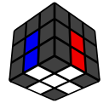
Improver Method – Pt. 1
Michael George
WCA ID: 2015GEOR02

Slide 2
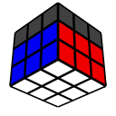
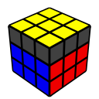
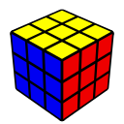
CFOP – Beginner to Expert
The Cross – 4 edges
First Two Layers (F2L)
Orientation of the Last Layer (OLL)
Permutation of the Last Layer (PLL)

Slide 3
Beginner Method - Summary
Massively simplified version of the CFOP method
Each of the 4 steps were split into 2 sub-steps
Cross – “Daisy” + “Cross”
F2L – Corners + Edges
OLL – Edge Orientation (EOLL) + Corner Orientation (OCLL)
PLL – Corner Permutation (CPLL) + Edge Permutation (EPLL)
Each sub-step was simplified to a single trigger / algorithm
The OLL algorithms were simple but near-optimal – F (U R U’ R’) F’ and beginner Anti-Sune
The PLL algorithms were simple but rather long – Anti-Sune and Niklas combinations
The simplicity of the “beginner” method makes it analogous to the “Bubble Sort” in computing
Do yourself a favor and upgrade it to the “improver” method!

Slide 4
Improver Method - Summary
Efficiency
Solve the cross directly, skipping the “Daisy” step which is only for beginners
Reduce the number of y / y’ rotations during F2L with 2 additional triggers
Reduce the number of moves and “looks” during OLL with 2 additional algorithms
Reduce the number of moves and “looks” during PLL with 2 additional algorithms
Tips
“Cross on bottom” gives the best visibility of unsolved pieces and helps with “look ahead”
“Finger tricks” is the term given to fast, ergonomic turns. They look cool and speed up your solves
Excessive “rotations” should be avoided because they waste time and affect spatial awareness
“Colour neutrality” helps to ensure a good start to your solves and is best learnt from the day one

Slide 5
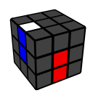
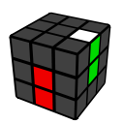
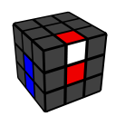
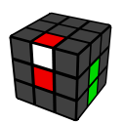
Cross - Basics
Methodical approach for cross pieces in the U-layer
Locate a cross piece in the U-layer
Place the cross piece above its centre
Solve the cross piece as shown
Note: Use y and y’ rotations to maximise L and R moves
L2
R2
U L F’ L’
U’ R’ F R

Slide 6
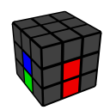
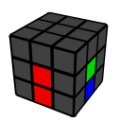
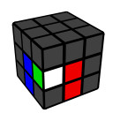
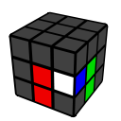
Cross – Trapped Edges
Methodical approach for trapped cross pieces
Locate a trapped cross piece
Liberate the cross piece as shown
Solve the cross piece as shown on the previous page
Note: Use y and y’ rotations to maximise L and R moves
L2
R2
L’ U’ L
R U R’

Slide 7
Improving your Cross
Solving the cross is an “intuitive” process and there are no algorithms as such. Advanced solvers will typically solve the cross in 6 moves or less but this requires a great deal of practice and experience!
Tips
Solve the cross directly without using the “Daisy” step
Always “Cross on Bottom” for increased visibility of cross pieces and F2L pairs
Try to adopt “Colour Neutrality” for easier starts to your solves
Try to influence tricky / unsolved cross edges whilst solving the current edge
Avoid unnecessary setup / restoration moves
Minimise cube rotations, especially y2 through the use of ”mirroring”, etc.

Slide 8
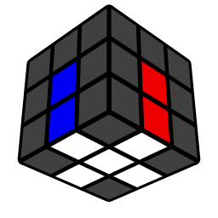
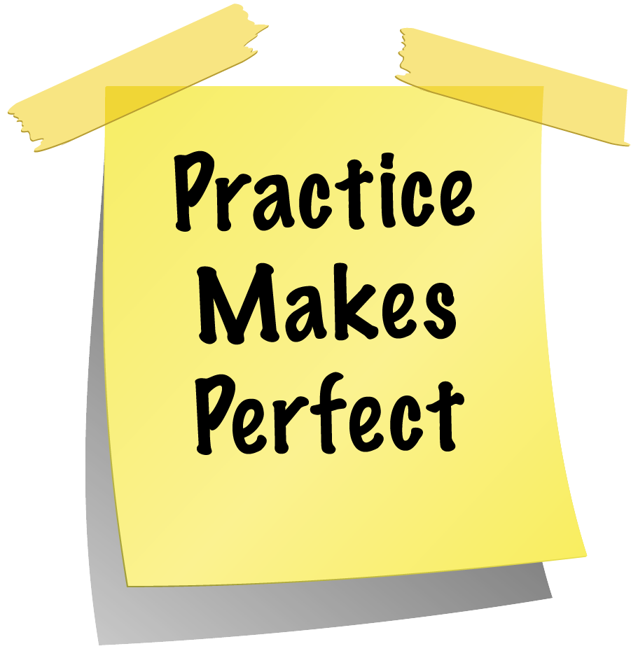
Homework

